Slide 1
Can eight Tomato plants be grown in 10 kg of soil?
April - 2016

Slide 2
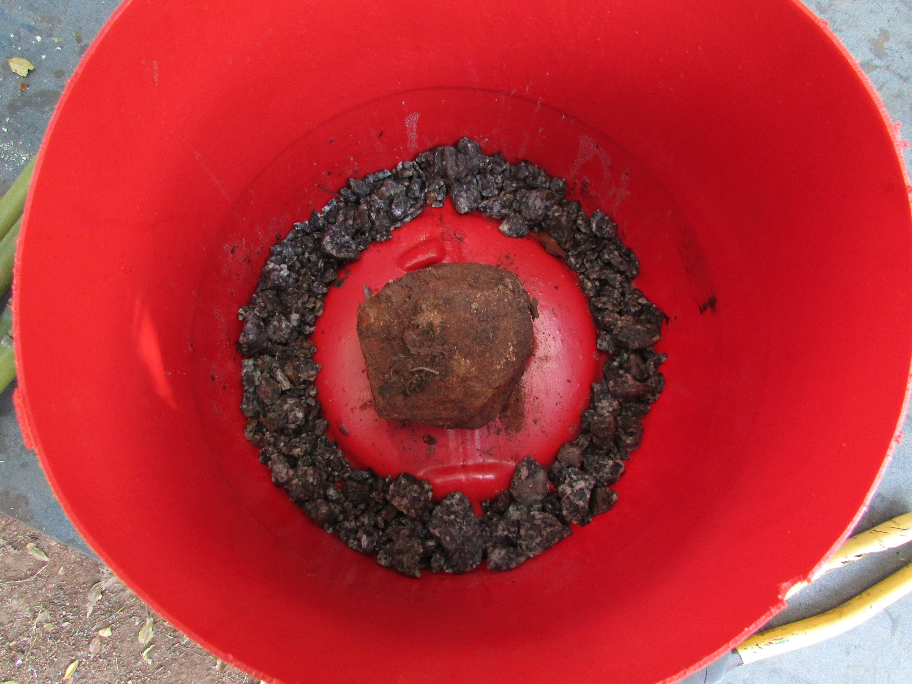
Drill drainage holes
and add gravel

Slide 3
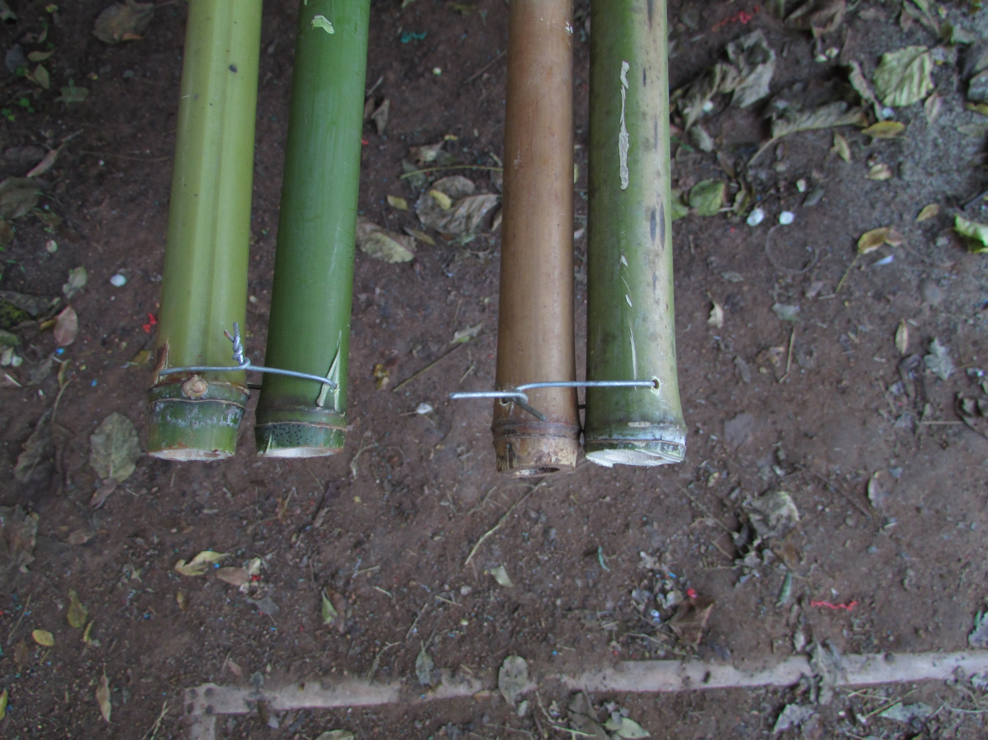
Cut four stakes and join them
in pairs at the thick end

Slide 4
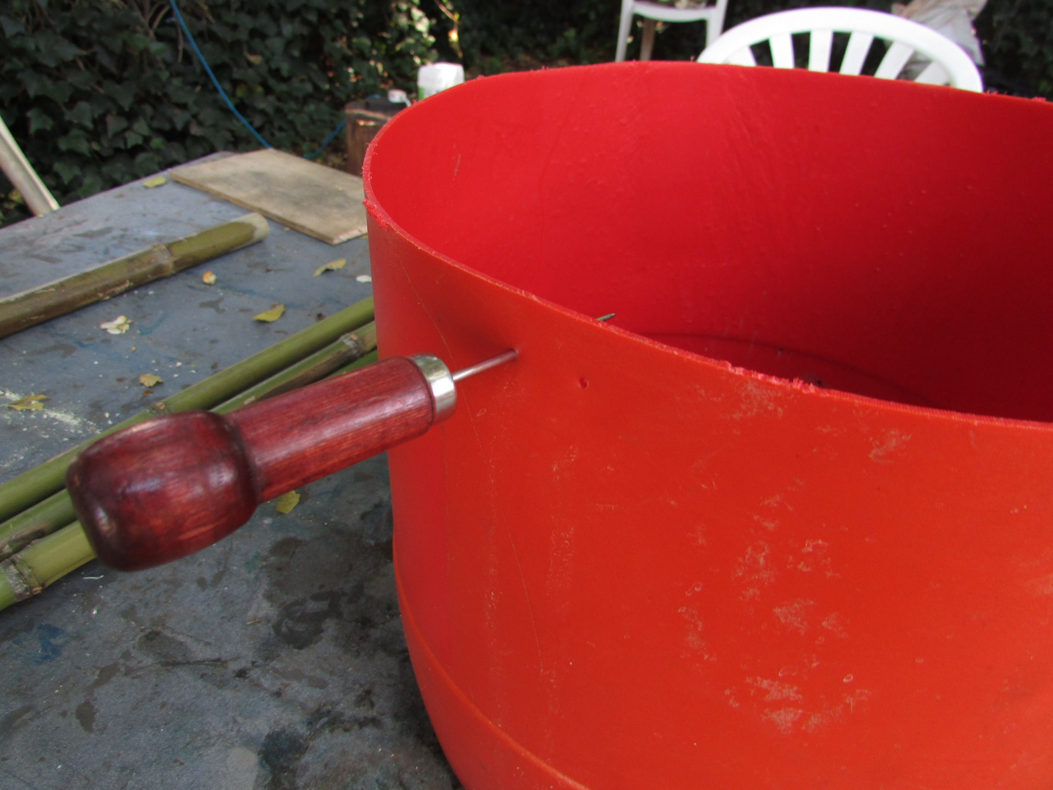
Punch four pairs of holes
North, South, East and West

Slide 5
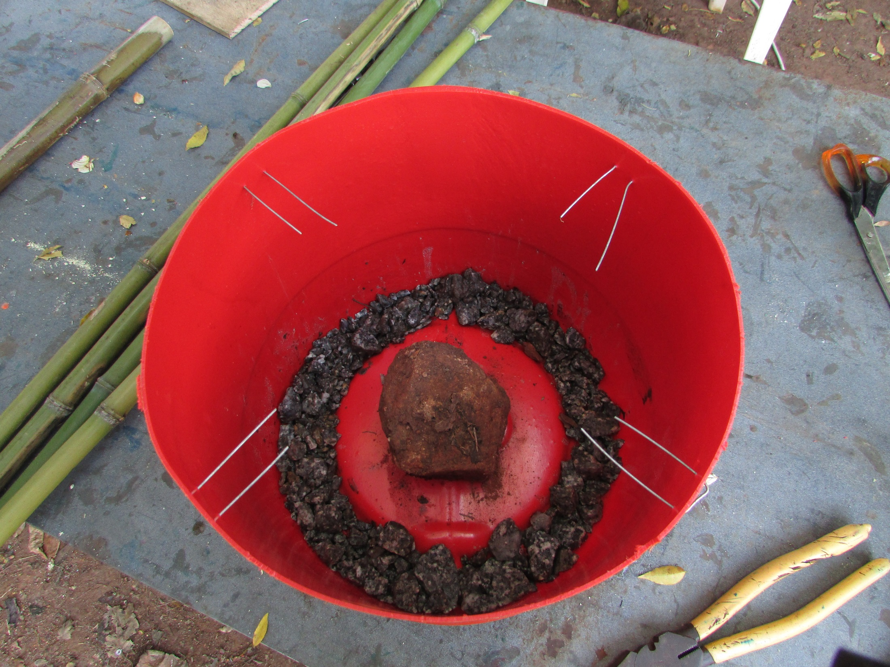
Binding wire

Slide 6
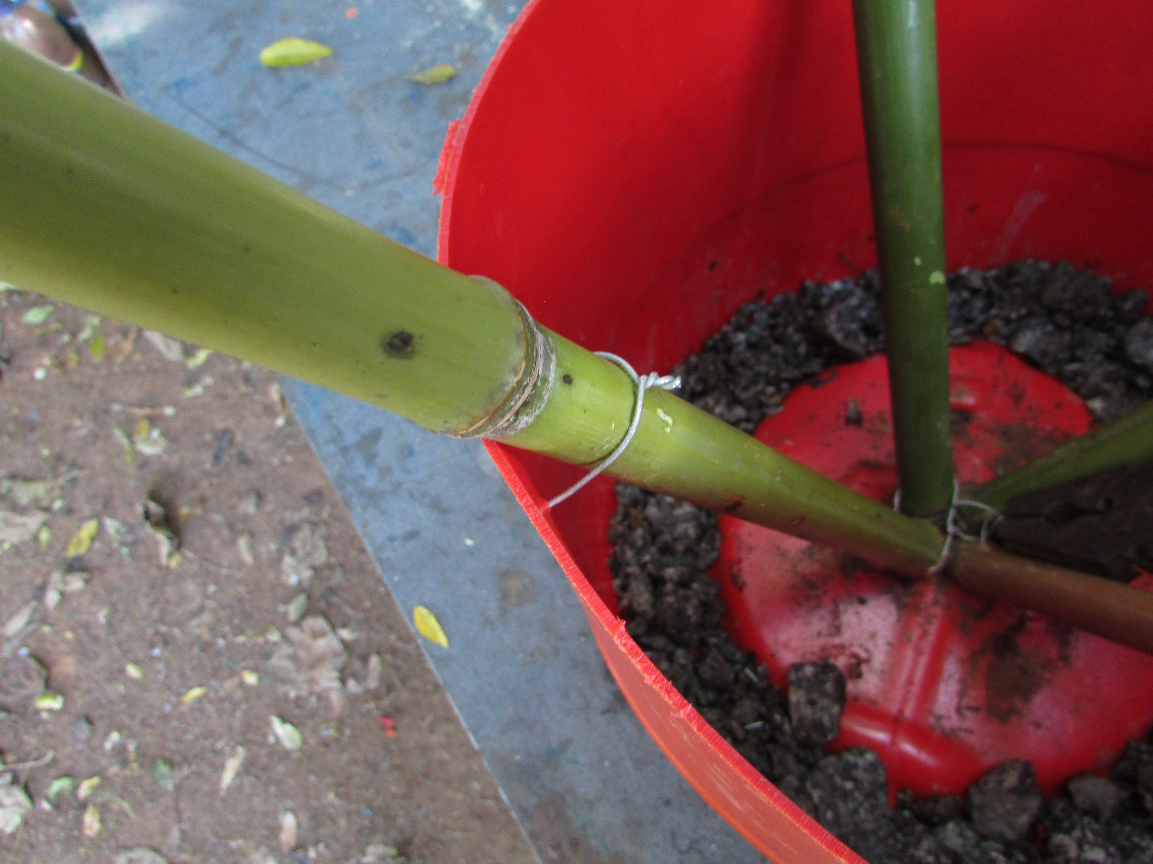

Slide 7
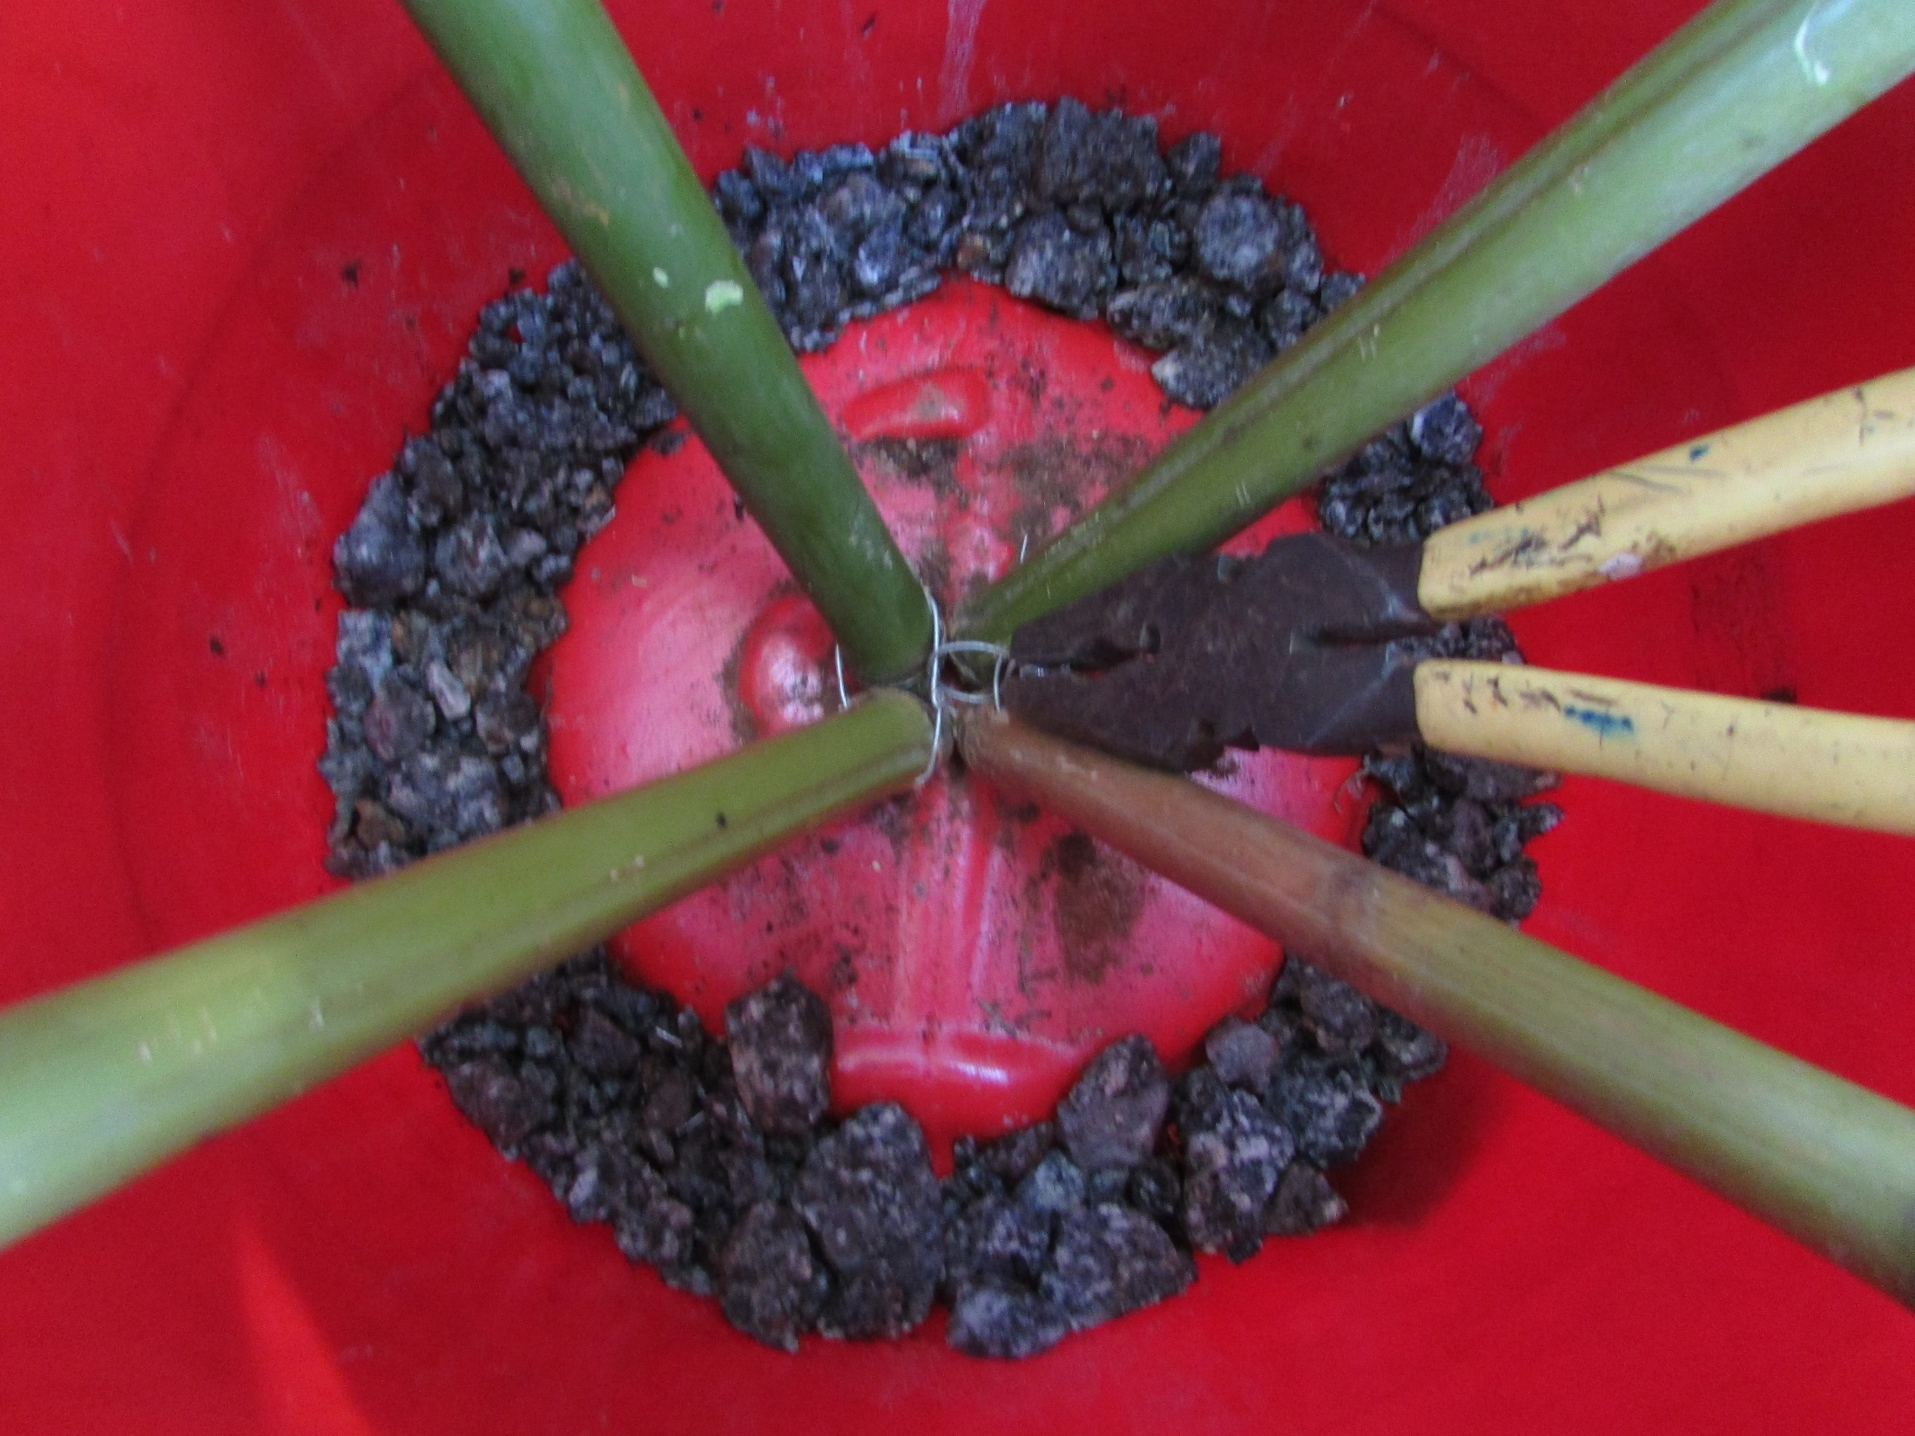
Bind pairs together

Slide 8
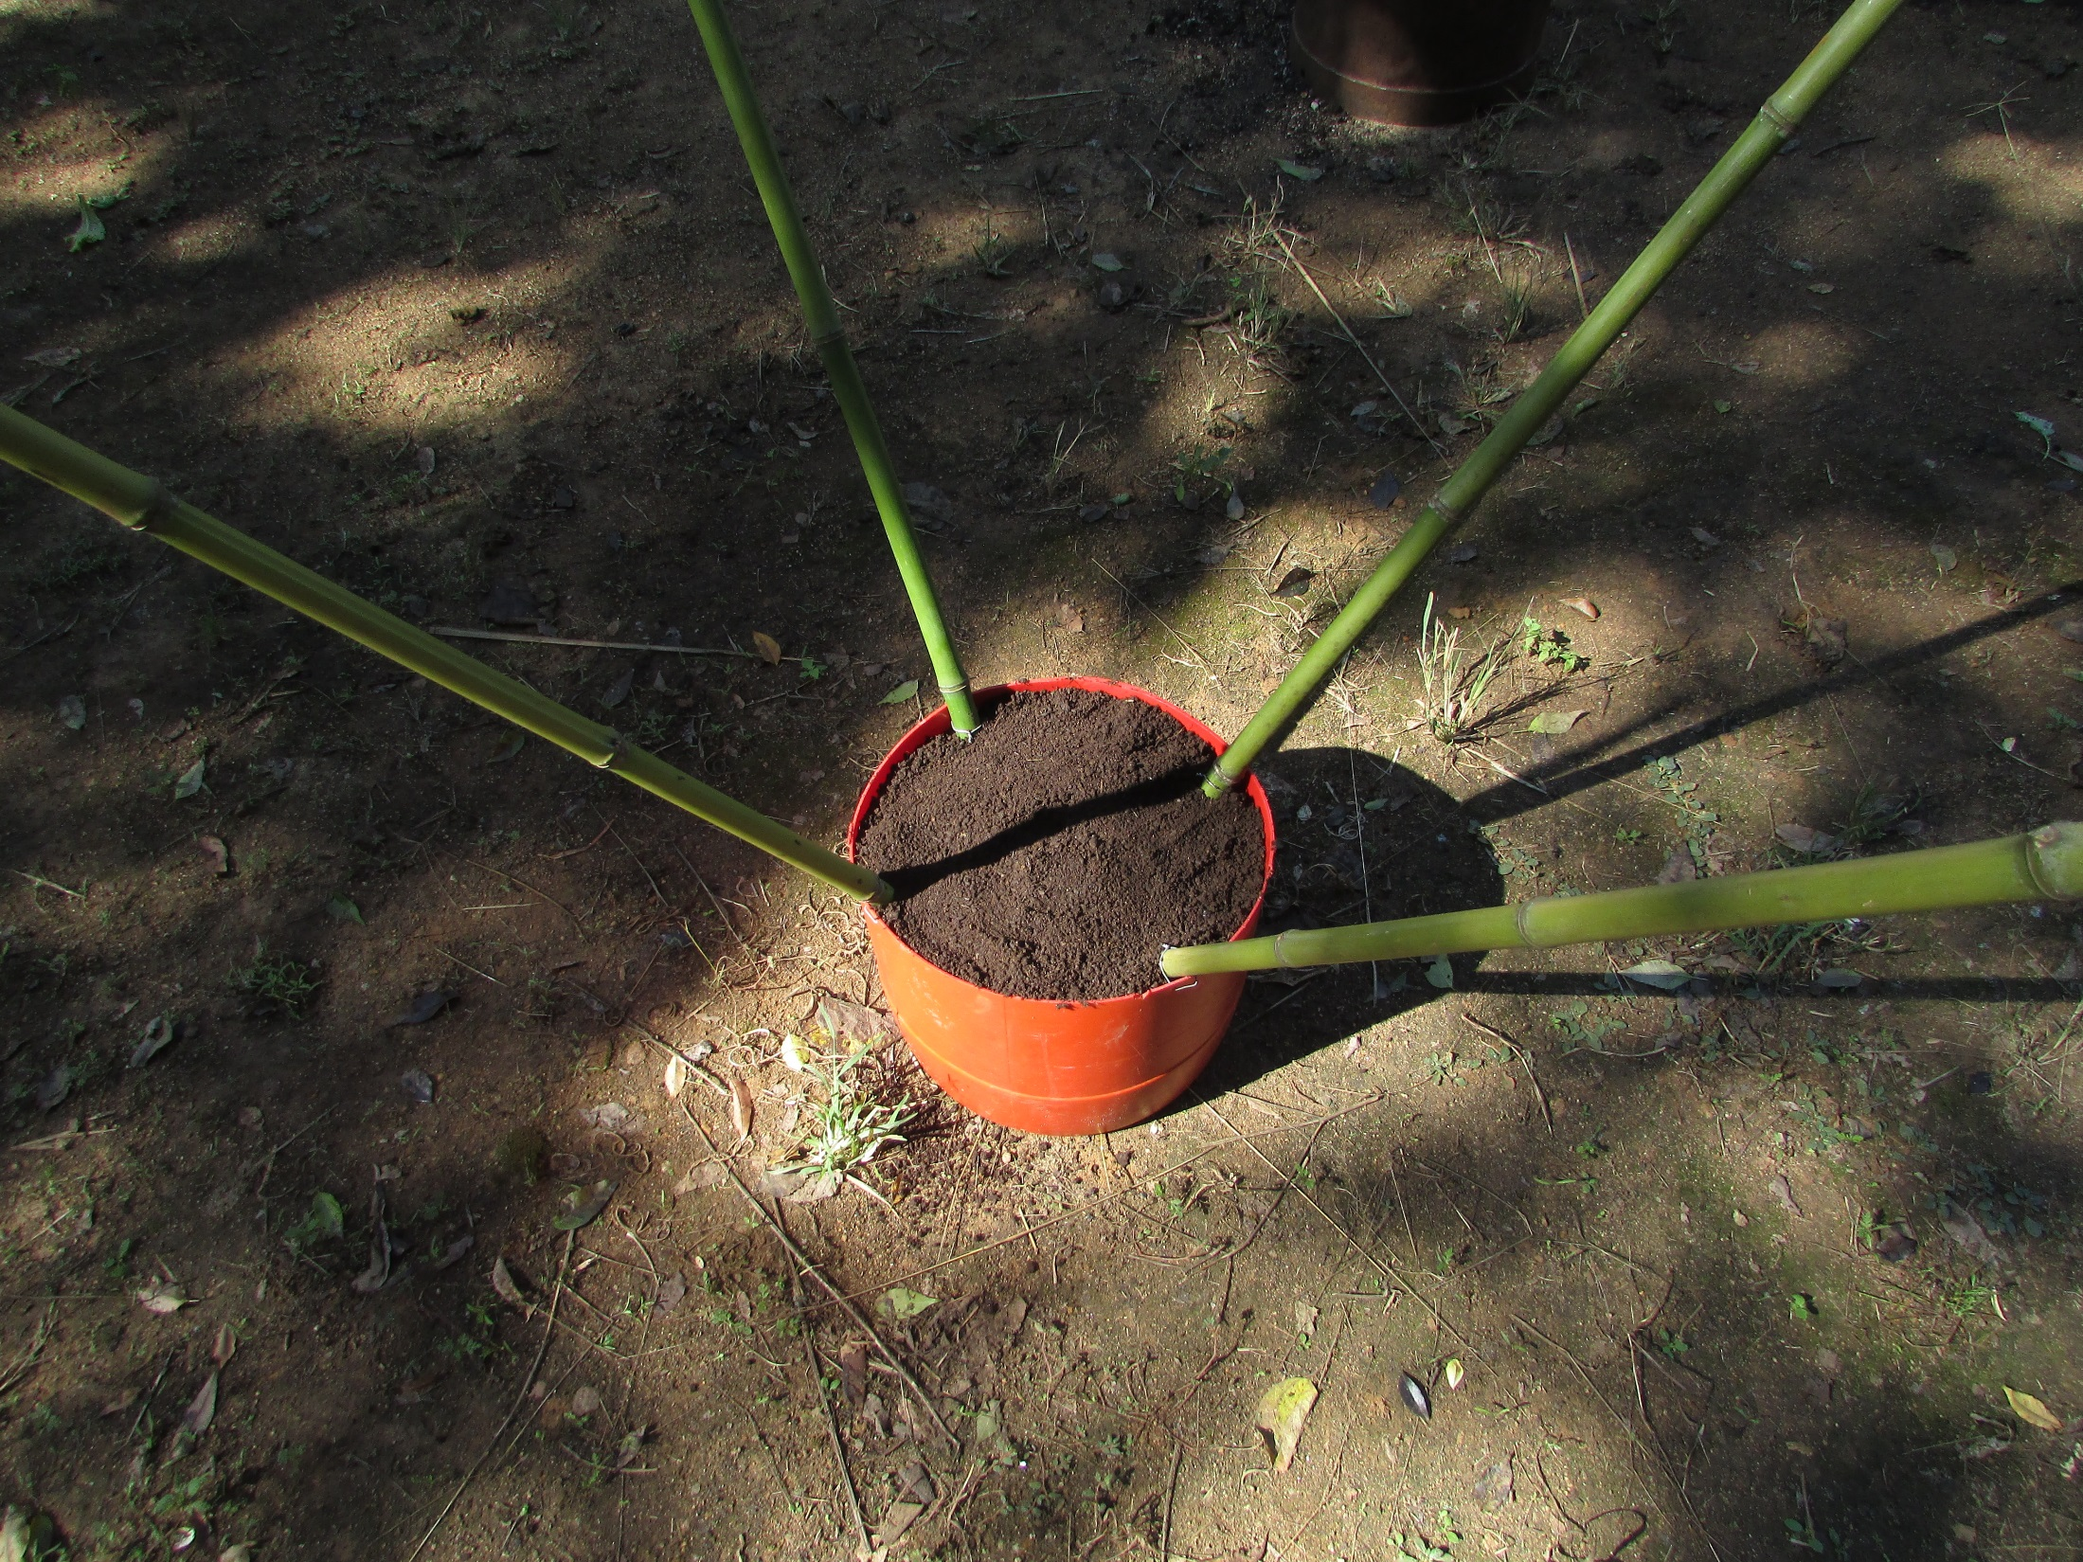
Add soil

Slide 9
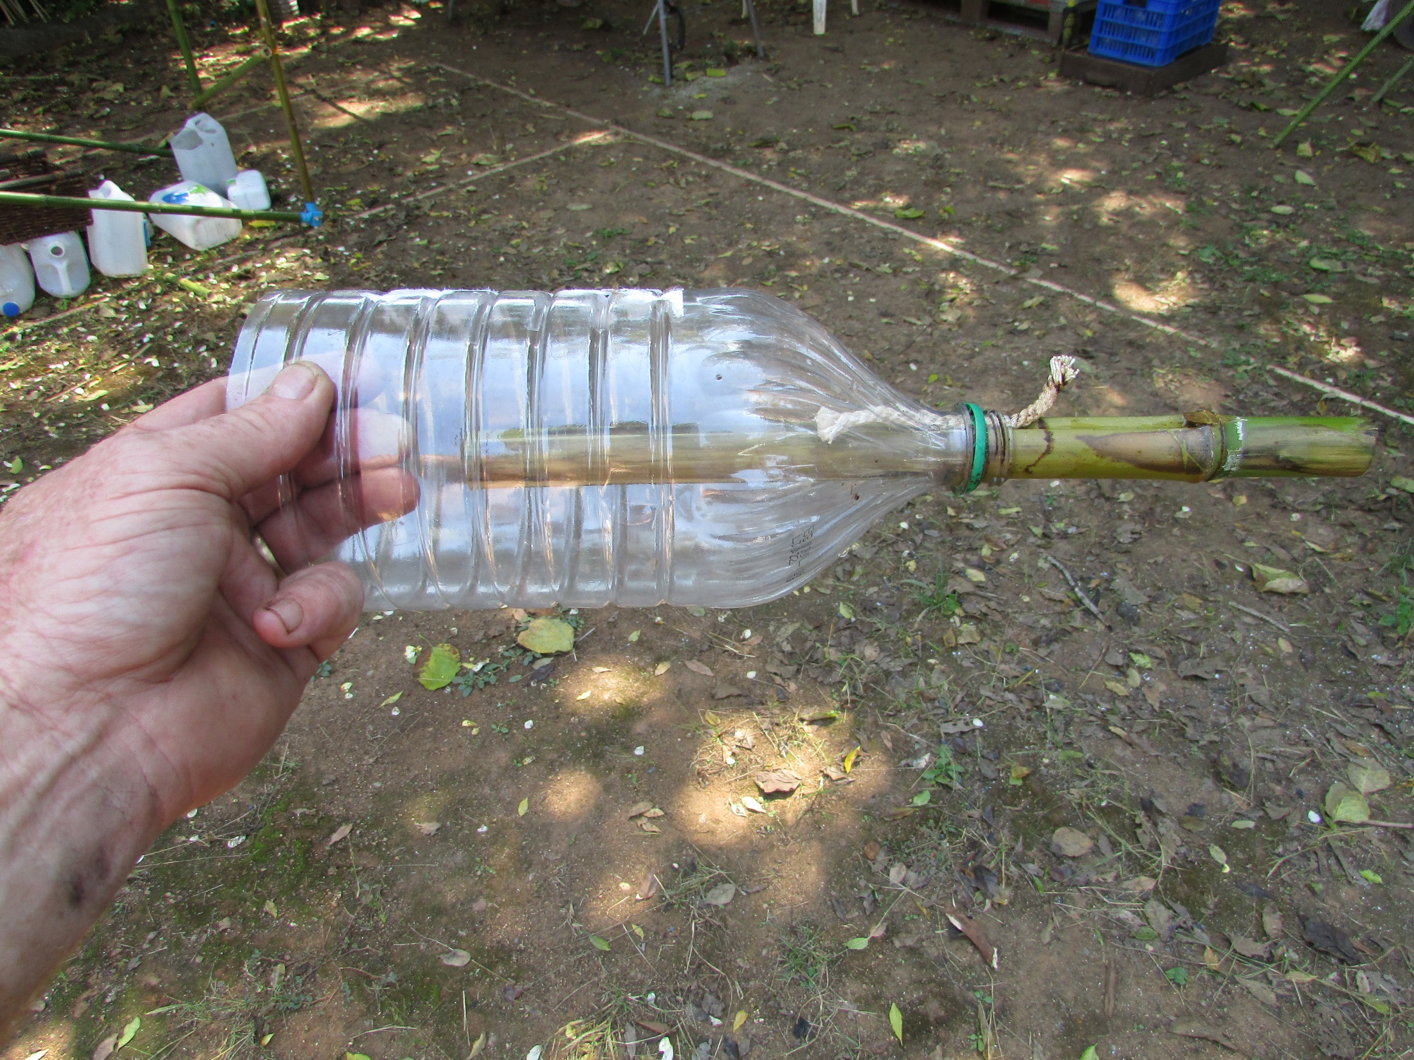

Slide 10
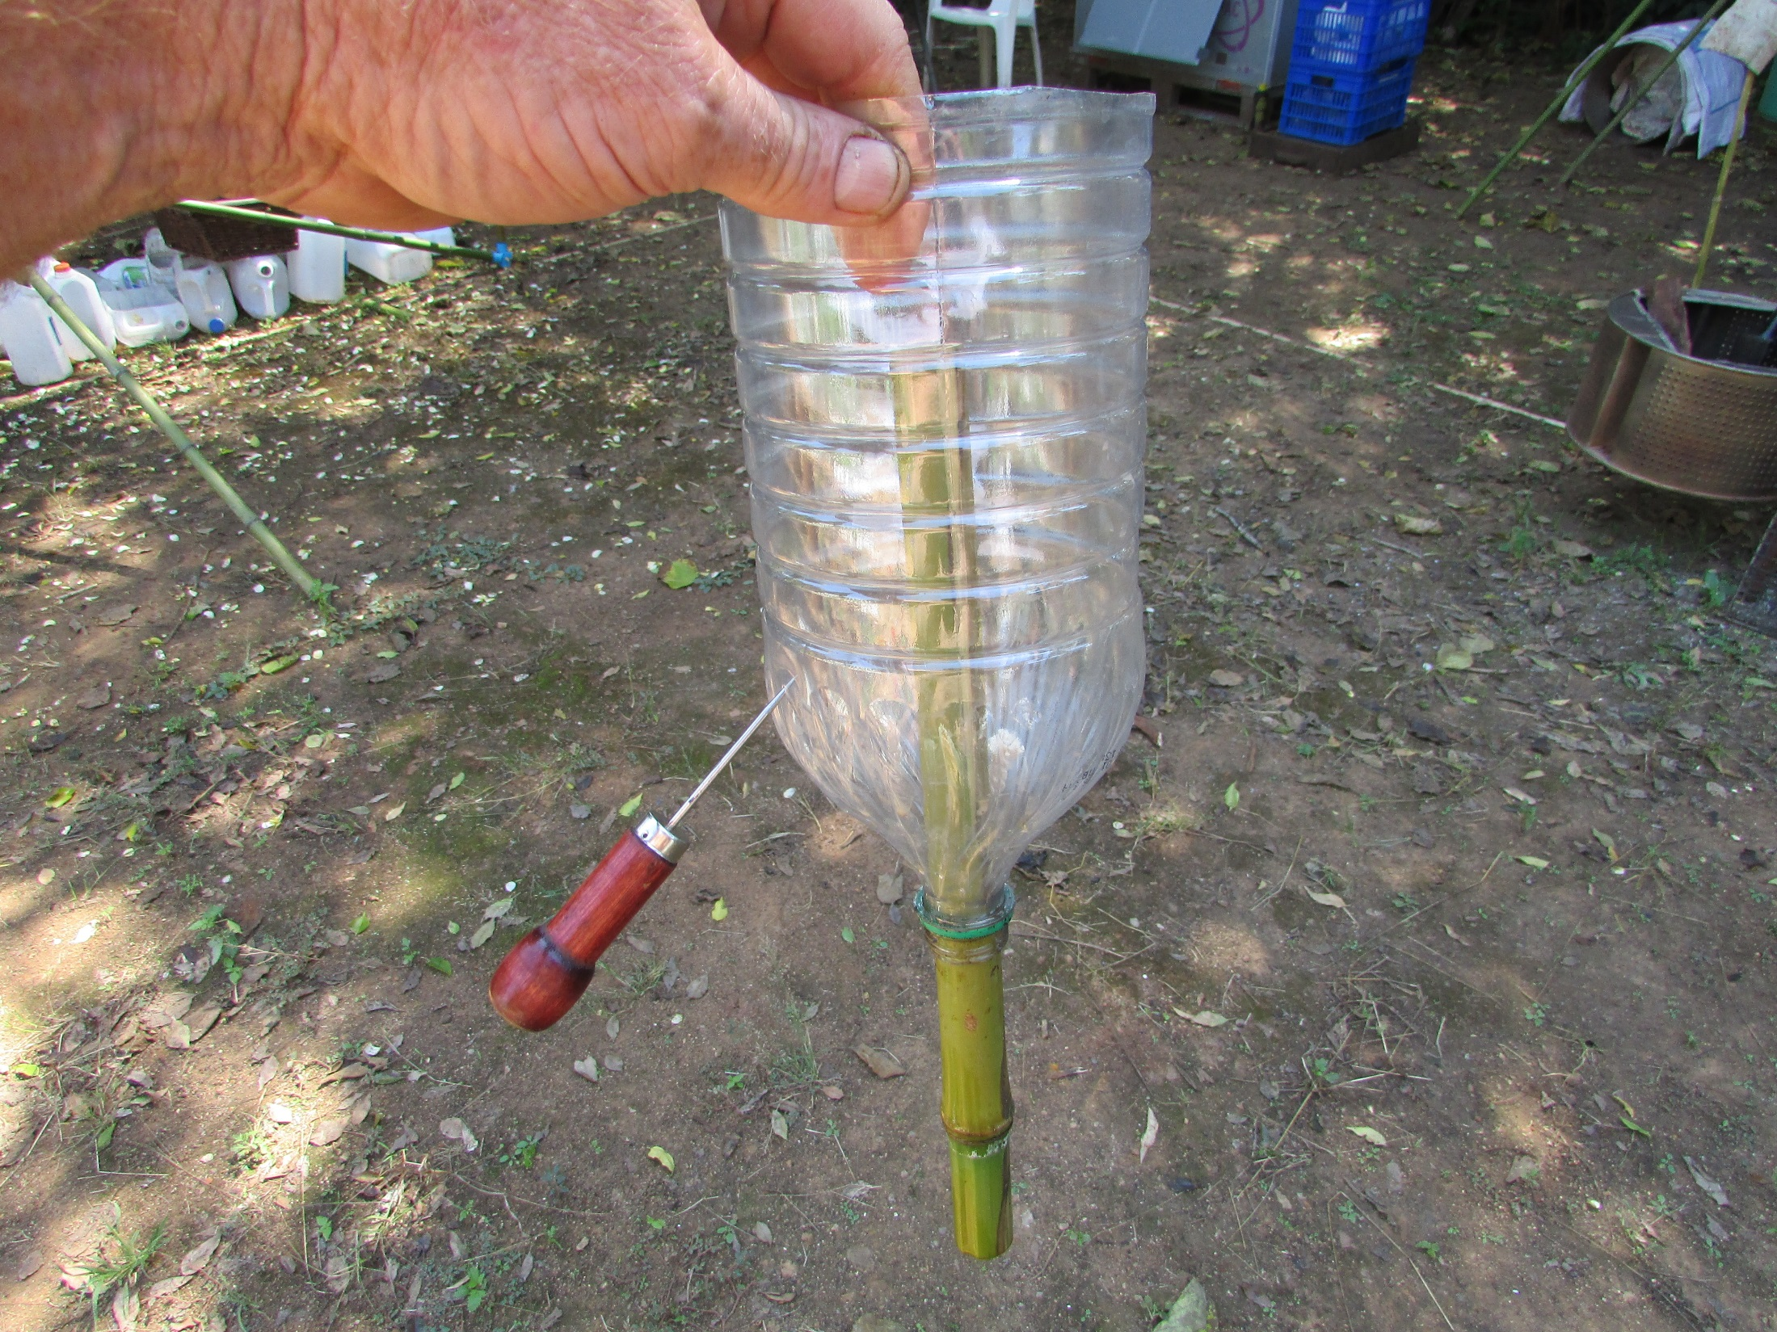
Punch four small holes
North, South, East and West

Slide 11
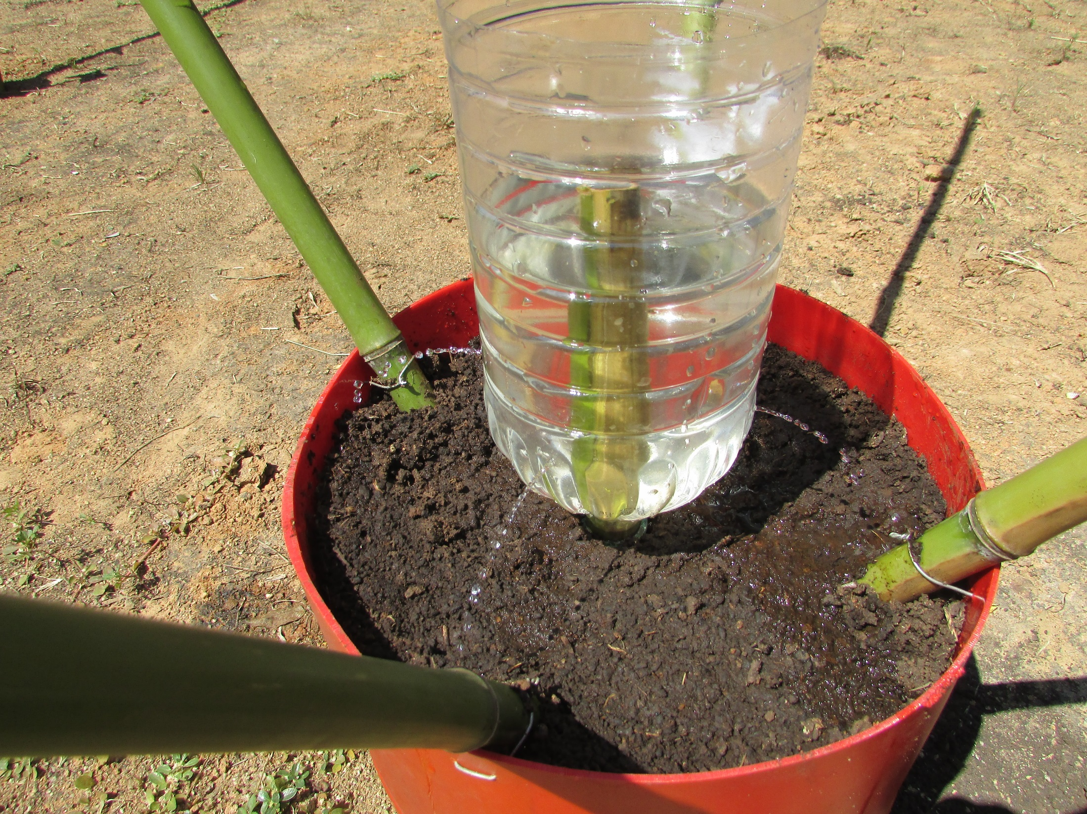

Slide 12
Plant two tomato seedlings
near each stake
See what yield you get from
eight plants in 10 kg??

Slide 13
